Slide 1
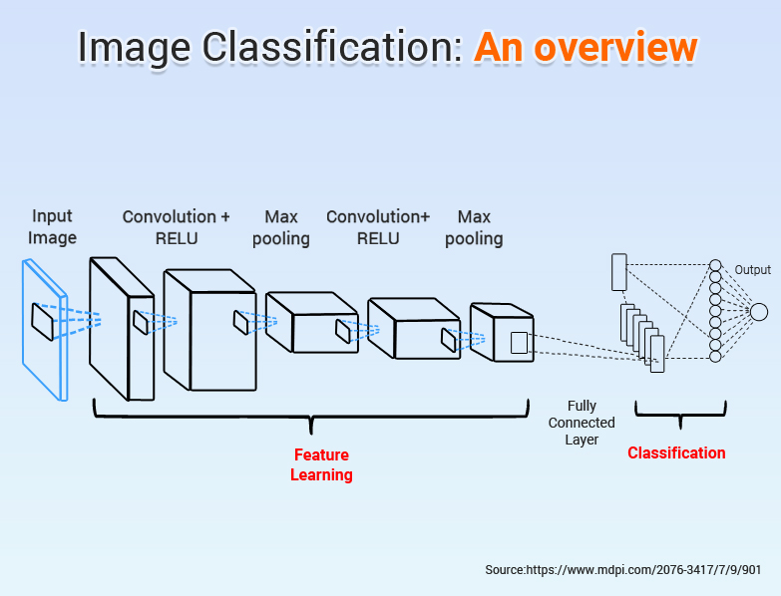
Image Classification by CNN
Credit image source-mdpi.com

Slide 2
Problem Statement:
Images are one of the major sources of data in the field of data science and AI. This field is making appropriate use of information that can be gathered through images by examining its features and details.
The idea behind this project is to build a deep learning-based Image Classification model on images that will be scraped from e-commerce portal. This is done to make the model more and more robust.
We are going to collect three images 1. Sarees (women), 2. Trousers(men),3. Jeans(men)after this data will provide as input to deep learning model to build image classification model that will classify between these 3 categories mentioned

Slide 3
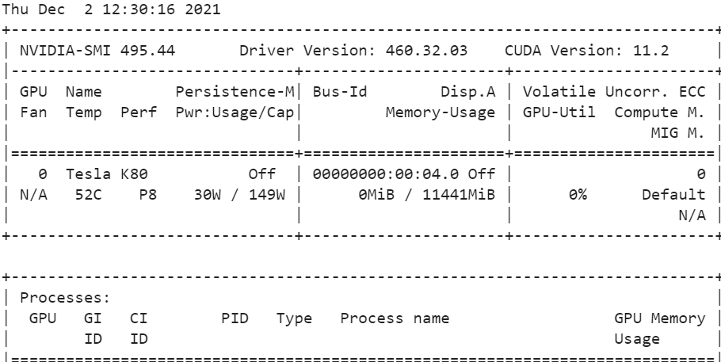
EDA(Exploratory data analysis )
First step to install tensorflow-gpu in google colab to build the model
Second step to call ! nvidia-smi to understand which GPU has allocated,so I got Tesla K80 GPU for this work

Slide 4
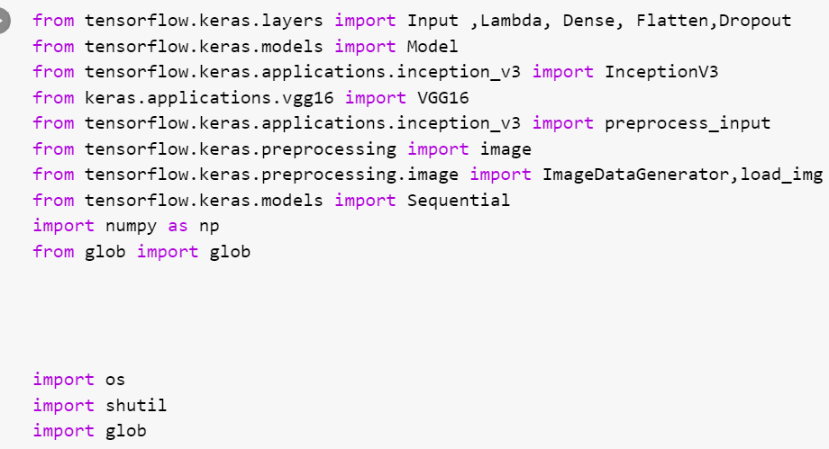
Library use for model building

Slide 5
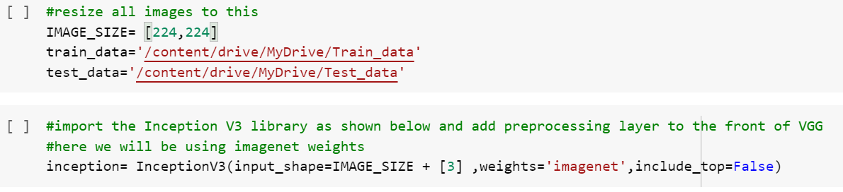
Data Resize
Next step we call train and test data which saved in google drive,resize all images so that pixel should same

Slide 6
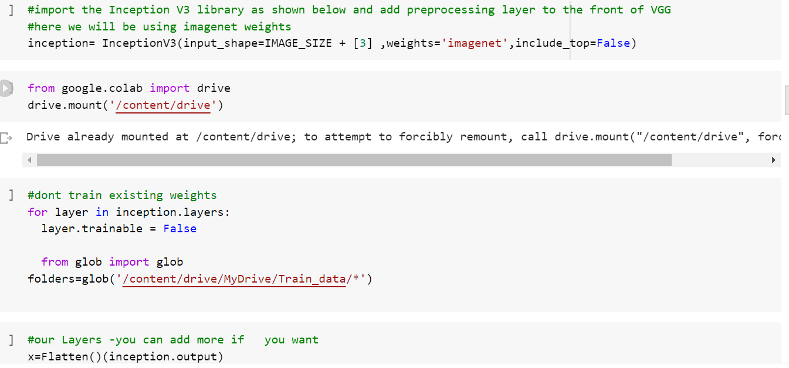
Using Transfer learning techniques ,flatten layer

Slide 7
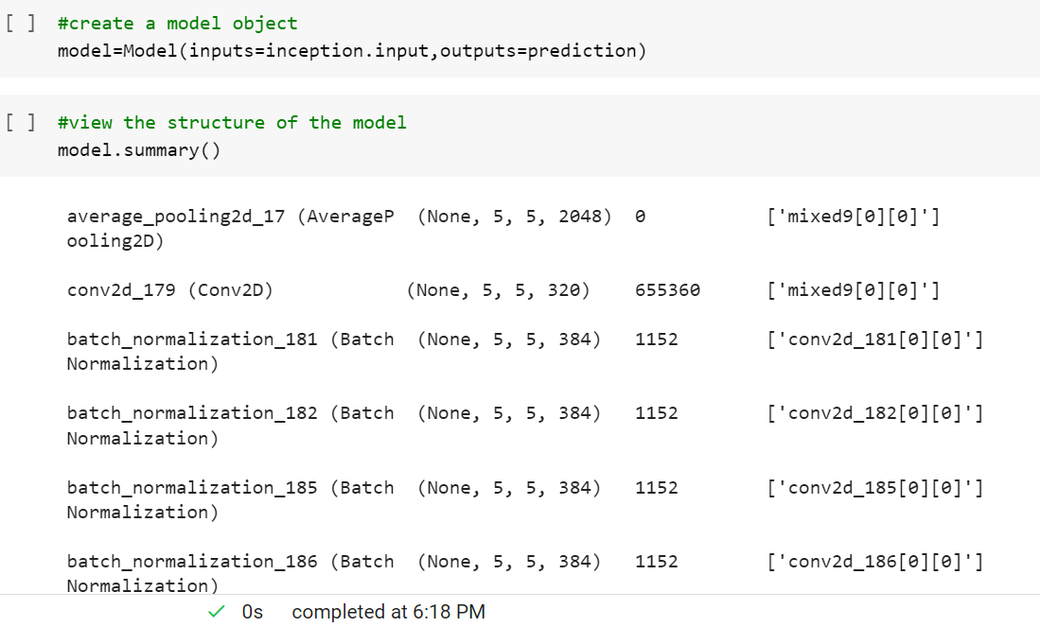
Creating Model object and model summary

Slide 8
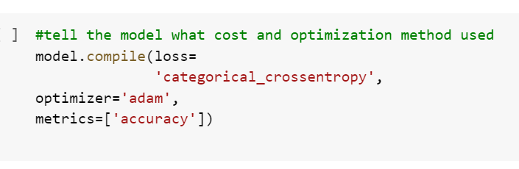
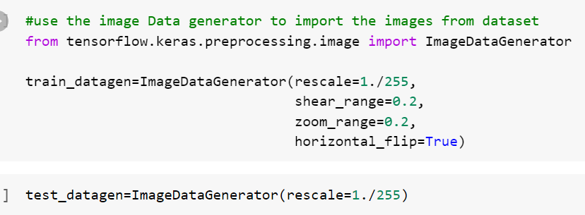
Model compile ,use image data generator

Slide 9
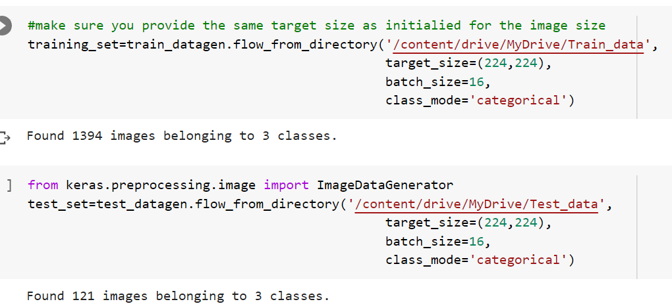
Reading all data from directory

Slide 10
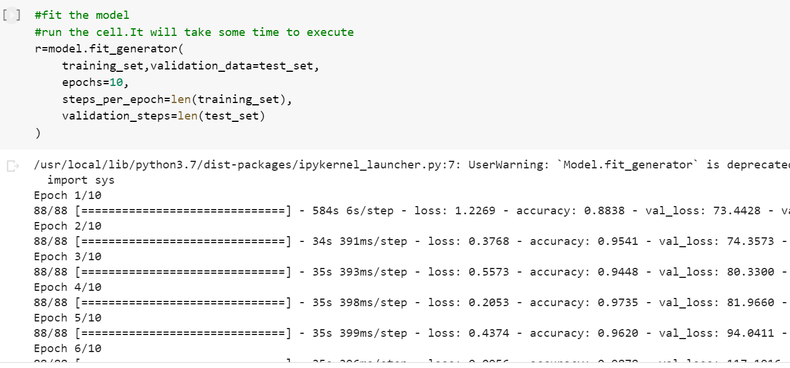
Fit the model & Run

